Slide 1

Possibilities of AI in teaching math
Taitaja 2023
Skill17 international competitors FI, HU, AT
Heikki, Viktor, Janos

Slide 2

AI is not here to take over the act of teaching; it is best used as a learning tool and to produce inspirational content.

Slide 3

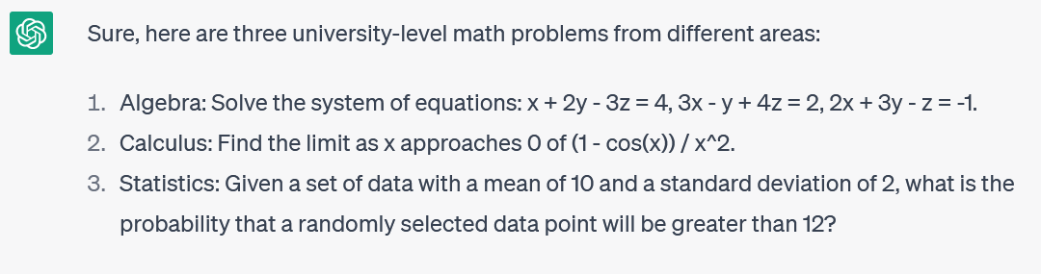
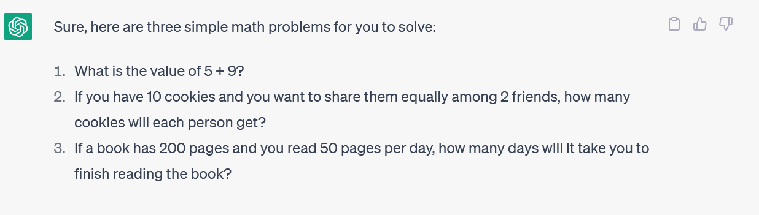
Future of AI
AI-powered tools will revolutionize math education by providing personalized, gamified learning experiences and facilitating collaboration among students.

Slide 4

The proposition
To learn math, you need to exercise with practice. For that, you need challenging tasks.
In conventional math games, tasks have some scheme to follow, and can easily run out.
With AI: the challenge level can be more suitable for each one’s level, and be just tailored to benefit most to learn with each one

Slide 5

Different possibilities of AI
Dedicated app
Wander off with AI Chats
Expansion of existing games
Customized platform in terms of user experience, most suited for age group and other factors
Difficulty follows the level of learner with each exercise
A more experienced learner can use the power of general AI-powered chats to escape the boundaries and to train just for specific problems and areas
Creates best exercises; requires knowledge of what to expect and how to ask
Use AI tools to generate infinite tasks or levels instead of limited set of game’s levels
Integrate into existing games easily by specifying “what is a level” and validating output format

Slide 6






Profits of teaching math using AI
Personalized Learning
AI can analyze a student's strengths and weaknesses to provide personalized math learning experiences
Adaptive Assesments
AI can provide adaptive math assessments that adjust to a child's skill level.
Gamification
AI can create math games that make learning more engaging and enjoyable for children
Personalized Feedback
Provide personalized feedback to help children understand their mistakes and improve their understanding of math
Interactivity
AI can create virtual simulations to help children visualize and understand math concepts
Collaborative
Connect students and facilitate collaborative math learning experiences to help children develop their social and communication skills while learning math.

Slide 7
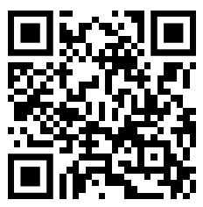
Demo time!
https://peaceful-flan-6b728f.netlify.app/

